Slide 1
MGMT590 - Visual Analytics
Session 5
Dr. Cecilia Ying
Updated: 09/14/2025

Slide 2
Today’s Agenda
Session 4
Assignment 1 Debrief
Special graphs “show and tell”
Storytelling with Data – Part 2
Part 1: Crafting a Compelling Story
Part 2: Articulating the Story
Kahoot!
Assignment 2 walkthrough (due Oct 3rd, 11:59 pm)

Slide 3
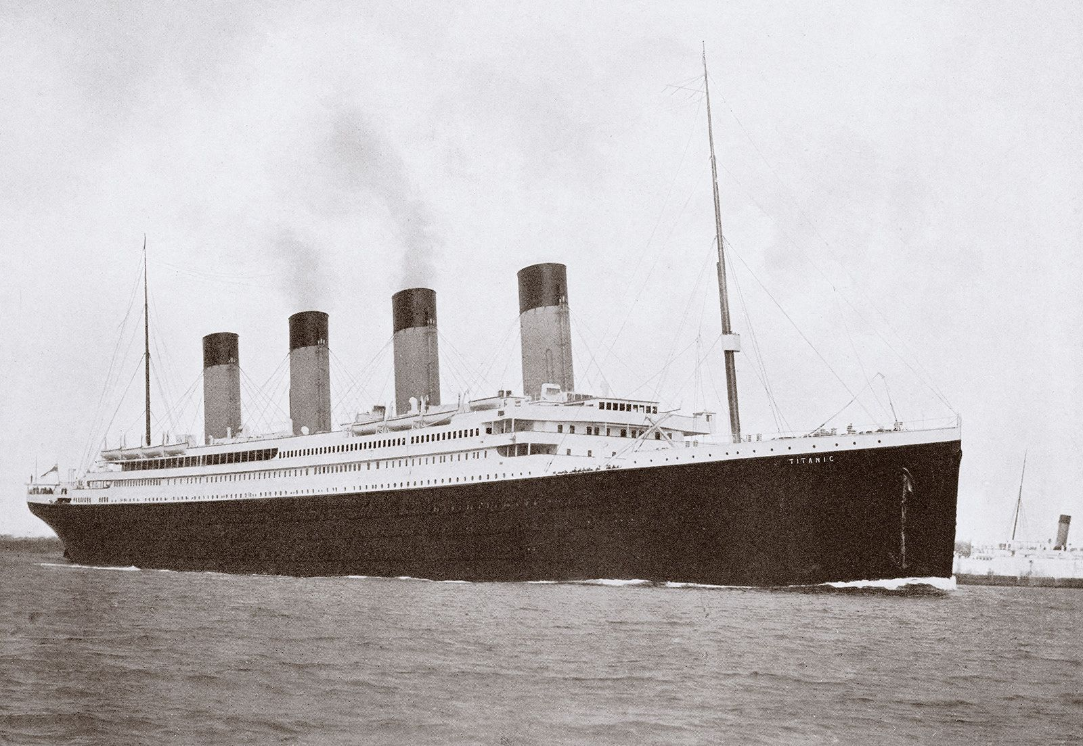
Assignment 1 – Titanic
Finding insights from the data
Data Understanding & Preparation
Assess the quality of the data
Create a plan to address (through data engineering)
Potentially incorrect data
Missing data
Collection of additional data that might be useful
Did we sink? Or did we swim?
Was it too difficult? Too easy?
What was the toughest part?
Did it take longer than you thought to complete?
Decision-making
Given the data you have and the understanding of who is more likely to survive, what else could be done to improve the survival rate?
Obviously, other than “adding more lifeboats”

Slide 4

Special Graph “Show and tell”

Slide 5
Module 4: Storytelling with Data
[Recap] Overview

Slide 6
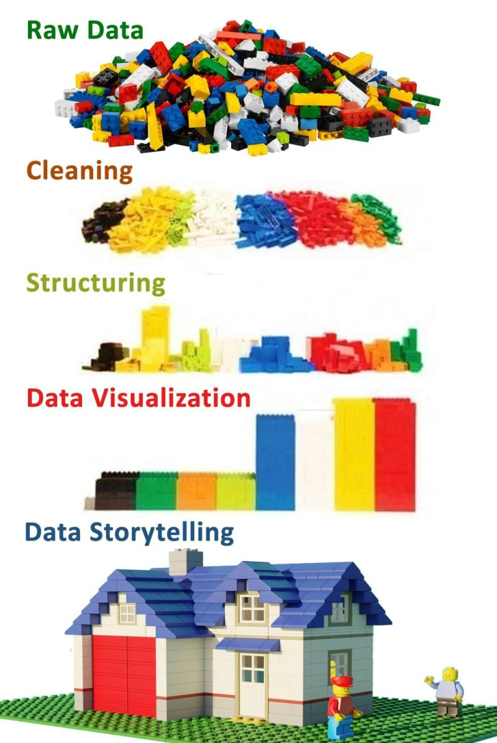
Storytelling with data
It’s just like building a house
Crafting the story
The architecture and blueprint
Creating a functional structure that meets the audience's needs.
Articulating the story
The construction and interior design
Using the right materials (visuals), a tidy look (decluttering), and clear signs (language) will make the house comfortable and easy to navigate.

Slide 7
Storytelling with Data
[Recap] Part 1 – Crafting a Compelling Story

Slide 8
WHAT is the story you are trying to tell?
Finding the narrative hidden within the data
1. Audience & Context (The Foundation)
2. The “Big Idea” (The Core Message)
3. The Narrative Arc (The Structure)
4. Conflict & Stakes (The Hook)

Slide 9
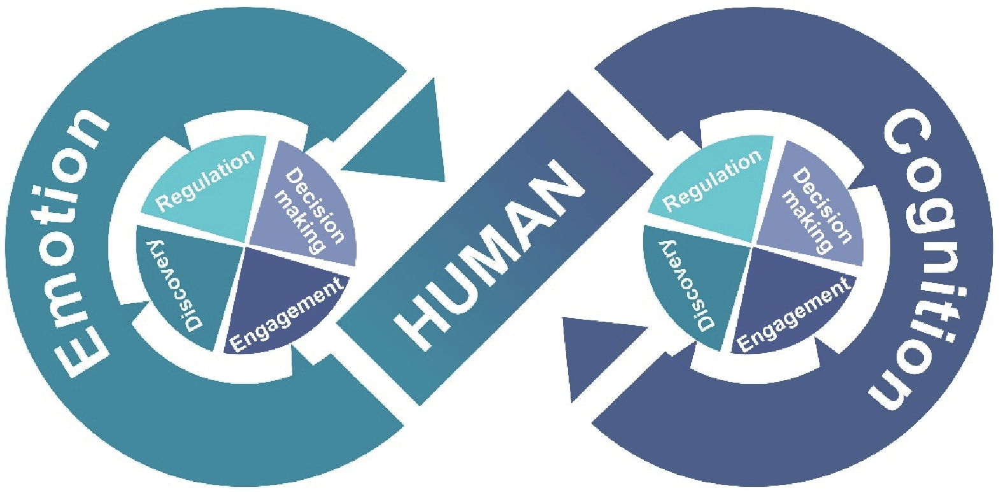
WHAT is the story you are trying to tell?
Finding the narrative hidden within the data
1. Audience & Context – The Foundation
There is an interconnected relationship between human emotion and human cognition, which drives decision-making.
Know your audience: Connect! Make them care!
Who are you talking to? What do they care about?
What is their level of expertise?
What decisions do they need to make? Or what decisions can they make?
What is the background context to help them connect -> to care
Zhao, G., Li, Y., & Xu, Q. (2022). From emotion AI to cognitive AI.
International Journal of Network Dynamics and Intelligence, 65-72.

Slide 10
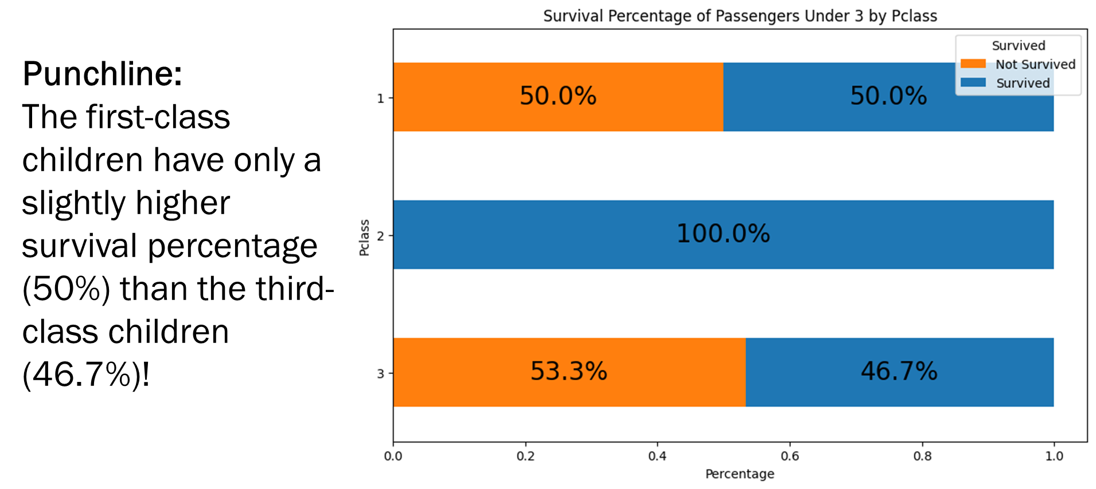
WHAT is the story you are trying to tell?
Finding the narrative hidden within the data
2. The “Big Idea” – The Core Message
This is the big “headline” of your story
Don’t just show the data, make a point!
Every piece of data, every chart, every talking point you include must directly support this one central message

Slide 11
WHAT is the story you are trying to tell?
Finding the narrative hidden within the data
3. The Narrative Arc – The Structure
The Hook
The Conflict
The Resolution
Every story needs a beginning, middle, and an end.
A good story focuses on a central conflict
Deliver your key finding or “Big Idea”:
Clear conclusion, a recommendation, or a call to action.
Present the supporting data and evidence:
The “Aha!” moments
Exploratory path that led you to your conclusion
Start with the context:
Present a problem, a question, or a surprising insight to grab the audience’s attention

Slide 12
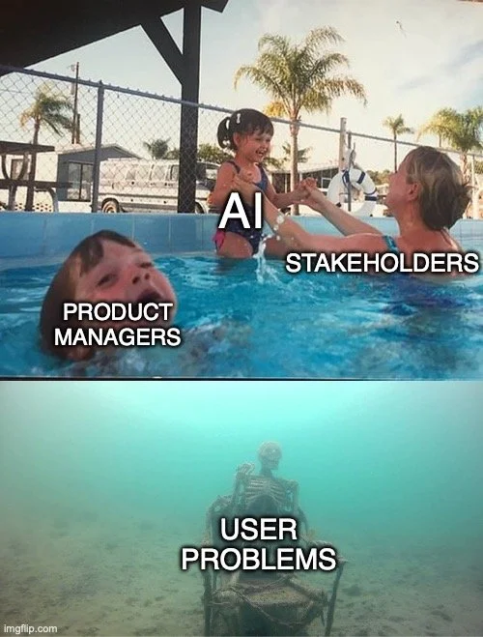
WHAT is the story you are trying to tell?
Finding the narrative hidden within the data
4. Conflict and Stakes – The Hook
“A story without conflict is just a report.”
The gap between “what is” and “what could be”
The problem you’re trying to solve
The opportunity you identified
Tension between two competing metrics

Slide 13
Storytelling with Data
Part 2 – Articulating that Compelling Story

Slide 14
Articulating the Story: The “HOW”
Clear, memorable, and persuasive
1. Choosing the Right Visuals (The Vehicle)
2. Focusing Attention (The Spotlight)
3. Clear and Concise (The Script)
4. The Narrative Flow (The Guideposts)

Slide 15
Articulating the Story: The “HOW”
Clear, memorable, and persuasive
1. Choosing the Right Visuals – The Vehicle
Don’t be fancy.
Be clear instead

Slide 16
Visualizing Relational, Distributions, Categorical Data
The three main types
Relational
Scatter plots, heatmaps, network diagrams
Distribution
Data shape, central tendency, outliers
Categorical
Comparing categories, proportions
Categorical or nominal data
Correlations, relationships between variables
Histograms, box plots, density plots
Continuous or numerical data
Continuous or discrete data
Bar charts, pie charts, violin plots, stacked bar charts
Remember this from Week 2?

Slide 17
Articulating the Story: The “HOW”
Clear, memorable, and persuasive
1. Choosing the Right Visuals – The Vehicle
Don’t be fancy.
Be clear instead
The visual is the primary interface between the audience and your data
Obscure or even misrepresent your message
BAD
GOOD
Make the insight obvious without a single word

Slide 18

Articulating the Story: The “HOW”
Clear, memorable, and persuasive
2. Focusing Attention – The Spotlight
Watch out for junk charts
Remove anything that isn’t adding informational value (unnecessary gridlines, borders, redundant labels, distracting colors)
Reduce cognitive load: our human brain has limited processing power.
Leave the junk with the trash panda and out of your graphs!

Slide 19
Articulating the Story: The “HOW”
Clear, memorable, and persuasive
3. Clear & Concise Language – The Script
Words and visuals work together
Use simple, direct language in your titles and labels
Instead of “Q1 sales by region,” highlight your big idea.
For example, “Region C drove 80% of Q1 growth”

Slide 20


Articulating the Story: The “HOW”
Clear, memorable, and persuasive
4. Narrative Flow – The Guideposts
Each slide or visual should build on the last
Each piece of evidence supports the Big Idea

Slide 21
What’s next?
Time flies when you’re having fun

Slide 22
Course Schedule
At a glance

Slide 23
Readings for next week
Case study – Analyzing and visualizing Bike-sharing Demand
Basole, R., Bendoly, E., Chandrasekaran, A., & Linderman, K. (2022). Visualization in operations management research. INFORMS Journal on Data Science, 1(2), 172-187.
Rennie, N., Cleophas, C., Sykulski, A. M., & Dost, F. (2023). Analysing and visualising bike-sharing demand with outliers. Discover Data, 1(1), 1.

Slide 24
How to use Power BI, Tableau, Excel/ VBA, Python, R…
Course objectives & preferred tools
Course objectives: Who, What, When, Where…
Exercising your managerial muscles
Focus on the story behind the data
You are free to use whatever graphical tools you are most familiar with (this course is not about the HOW)
Power BI Workshop next Tuesday during TA office hours.

Slide 25


Game on…
Go to https://kahoot.it/ or open the Kahoot mobile app and tap Join
Enter the game PIN
Enter your name and join

Slide 26
Assignment 2
Crafting and articulating that Compelling Story

Slide 27
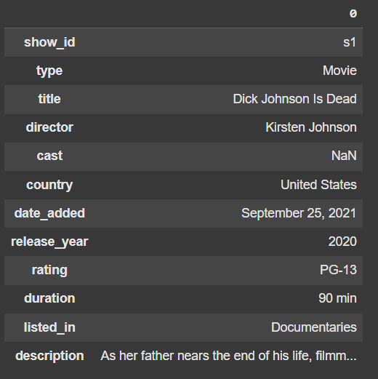
Dataset
https://www.kaggle.com/datasets/shivamb/netflix-shows
About this Dataset: Netflix is one of the most popular media and video streaming platforms. They have over 8000 movies or TV shows available on their platform. As of mid-2021, they have over 200 million subscribers globally.
This tabular dataset consists of listings of all the movies and TV shows available on Netflix, along with details such as cast, directors, ratings, release year, duration, etc.

Slide 28
Context
Counter the threat of GenAI-generated movies: a study of Rajiv Chilaka vs. Martin Scorsese
You have been hired by a cool animation startup in LA to draw insights from the works of Rajiv Chilaka and Martin Scorsese based on the data available in this dataset.
You will then use these insights to recommend strategies for them to counter the threat of GenAI-generated movies.

Slide 29

Rajiv Chilaka
Highest number of directed movies in the dataset
Rajiv Chilaka is an Indian animation filmmaker known for his work on shows like “Chhota Bheem” and “KikoRiki”.

Slide 30

Martin Scorsese
You know… the guy who directed Goodfellas, The Departed, The Irishman, etc.
Martin Scorsese is an American film director known for his gritty, intense films like “Goodfellas”, “The Departed”, and “The Irishman”.

Slide 31
Deliverables
Executive Summary & Supporting Analysis
A one-page executive summary detailing the analysis, insights, and recommendations.
One killer figure.
Additional supporting analysis can be included as an appendix.

Slide 32
Grading Criteria
How well can you craft and articulate the story
Crafting the Compelling Story (50%)
Depth and relevance of insights drawn from the data analysis
Articulating the Compelling Story (50%)
Clarity, coherence, and organization of the executive summary
Effectiveness of recommendations for countering GenAI threats
Originality and creativity of the approach
Ability to identify and leverage key relationships, trends and patterns in the data
Use of effective visualizations to support findings and recommendations
Ability to communicate complex ideas and insights in a clear and concise manner

Slide 33
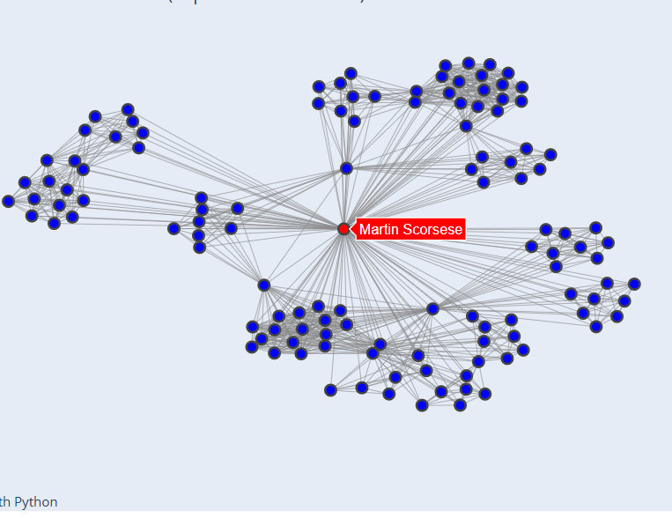
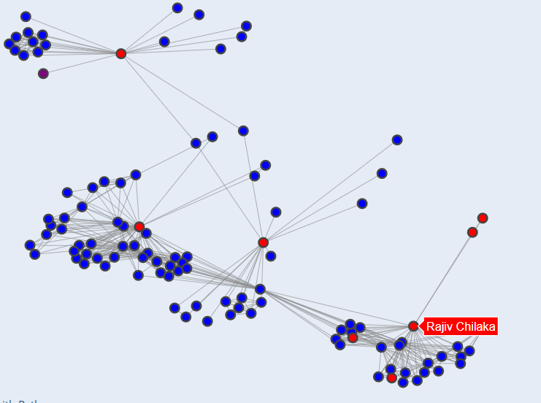
Network analysis
Who are these guys working with?
More on this next week

Slide 34
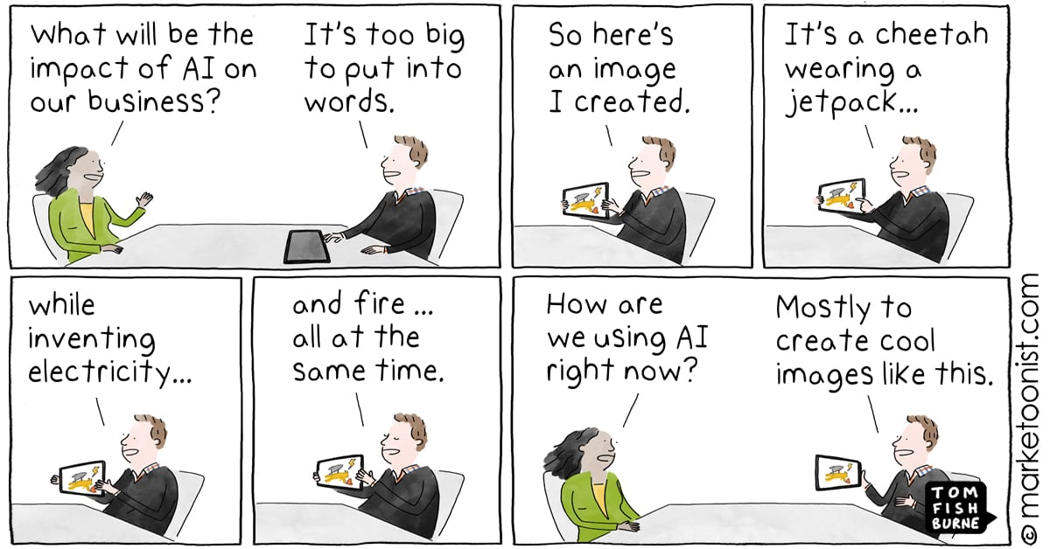

Slide 35
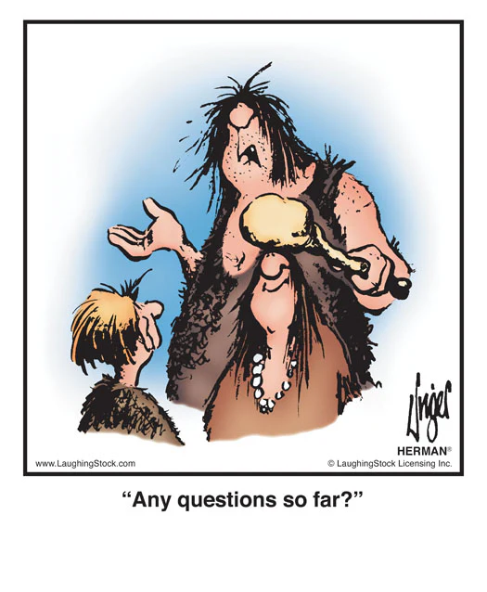
Questions?

Slide 36

That’s a wrap

Slide 37
Team Project
Building your “killer figure”

Slide 38
Team Project Description
Building your “killer figure”
Context
You are pitching a business case to a group of senior technology executives at your company, but a call came in, and the CTO will have to leave the meeting in 5 minutes.

Slide 39
Team Project Description
Building your “killer figure”
Challenge
You have 5 minutes to summarize your key findings, assumptions, and/or projections to convince your CTO that YOUR project is worth funding.

Slide 40

Ryan Buell’s famous “Killer Figure”
Professor from Harvard Business School https://www.hbs.edu/faculty/Pages/profile.aspx?facId=320524
“You should be able to summarize your entire presentation using ONE KILLER FIGURE.”

Slide 41
Team Project Description
Building your “killer figure”
Your Tasks
Identify a domain that is interesting to your team.
Find a dataset in that domain (common places to look: HuggingFace, Kaggle, UCI, Papers with Code)
Craft a project idea based on the data you are using (more on the next slide)
Create one killer figure that clearly tells your story
5-minute in-class presentation using the killer figure

Slide 42
Team Project Description
Building your “killer figure”
Project Objectives
Crafting a compelling story with data
Clearly articulate that story with one killer figure
Be creative and have fun

Slide 43
Team Project Description
Building your “killer figure”
Crafting Your Idea
What problems are you trying to solve?
What questions are you trying to answer?
What kind of data will you need?

Slide 44
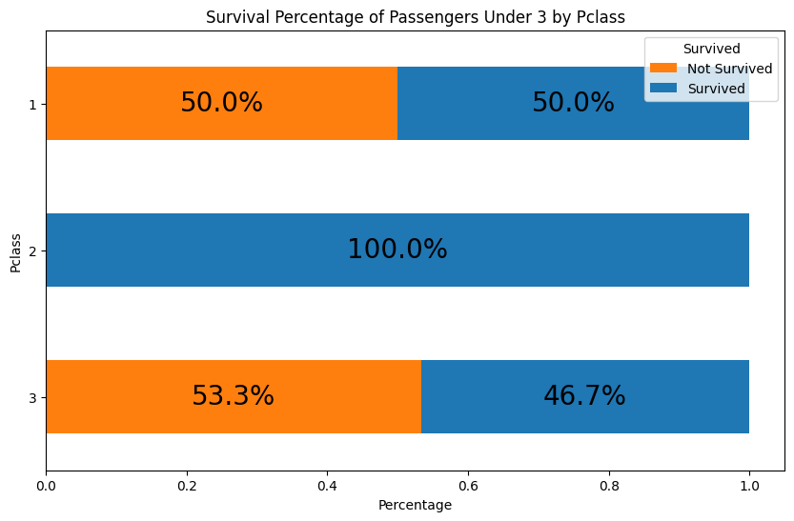
Team Project Description
Building your “killer figure”
Punchline:
The first-class children have only a slightly higher survival percentage (50%) than the third-class children (46.7%)!

Slide 45
Team Project Description
Building your “killer figure”
The first-class children pay, on average $151, which is 6 times higher than third-class children, who pay, on average $23. And yet, the company failed to ensure their safety.
Business proposal to
Improve the overall survival percentage for all children.

Slide 46
Team Project Description
Building your “killer figure”
Watch this video for inspiration (as needed)
How Consulting Firms Make Complex Topics Simple
Analyst Academy

Slide 47
Common Data Sources
Some recommendations
Huggingface: https://huggingface.co/docs/datasets/en/index
Kaggle: https://www.kaggle.com/datasets (Here you will also easily find code/notebooks from others, but be careful when using someone else's code - it might take more time to debug than write your own)
UCI: https://archive.ics.uci.edu/datasets
Papers with code: https://paperswithcode.com/datasets (this one is great if you want to read the research that's been done on the particular dataset)

Slide 48

Questions?

